Slide 1

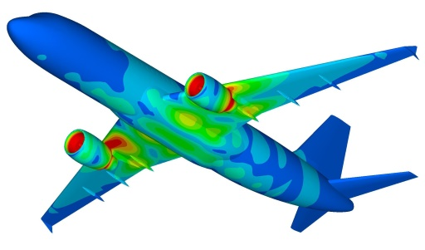


Non-linear Equations: Roots Finding
y
L₁
x
x₁
x₂
Dr. Himanshu Pathak
himanshu@iitmandi.ac.in

Slide 2


Roots/Zeros of Equations
Recall that a second order polynomial may be written in the general form
where a, b, c, are real numbers.
Root of this equation can b directly found as:
Find roots for equation Tedious!!!
Objective is to find a solution of f(x) = 0
“f(x)” is a polynomial or a transcendental function, given explicitly.
$$ax2+bx+c=0$$

Slide 3

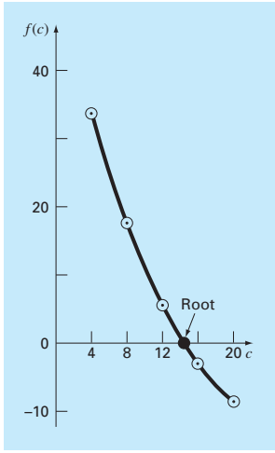
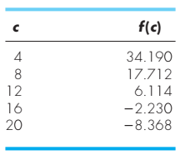
Graphical Method
Estimate of the root of the equation f(x) = 0.
Make a plot of the function and observe where it crosses the x axis.
The x value for which f(x) =0, provides a rough approximation of the root.
Example 1: Get the root for the given equation by Graphical method using the parameters t = 10, g = 9.81, v = 40, and m = 68.1
Root solution
c ≈14.75

Slide 4
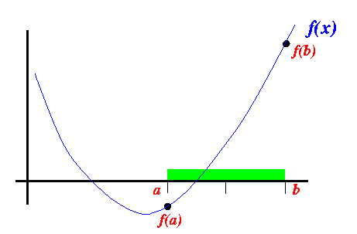
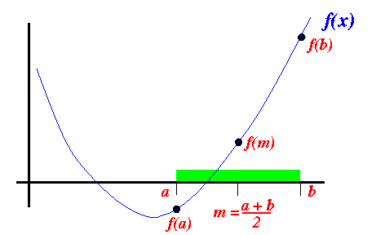
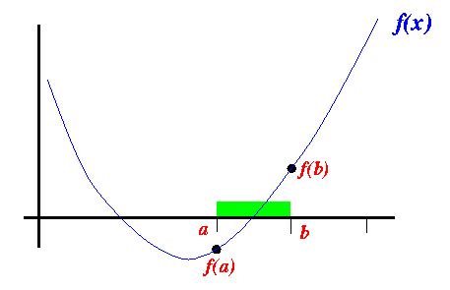
Bisection Method
A successive approximation method that narrows down an interval that contains a root of the function f(x).
Cuts the interval into 2 halves and check which half interval contains a root of the function

Slide 5
Bisection Method
Step 1: Choose lower x_{l} and upper x_{u} guesses for the root such that the function changes sign over the interval.
f(x_{l})f(x_{u}) < 0.
Step 2: An estimate of the root x_{m} as x_{m} = (x_{l} + x_{u})/2
Step 3: Make the following evaluations to determine in which subinterval the root lies:
(a) If f(x_{l})f(x_{m}) < 0, the root lies in the lower subinterval.
Set x_{u}= x_{m} and return to step 2.
(b) If f(x_{l})f(x_{m}) > 0, the root lies in the upper subinterval.
Set x_{l}= x_{m} and return to step 2.
(c) If f(x_{l})f(x_{m}) = 0, the root equals x_{m};
Terminate the computation.

Slide 6
Bisection Method
Example 1: find the root of f(x) = x² − 5
Initial Range x_{l} = 0; f(x_{l}) = -5
x_{u} = 4; f(x_{u}) = 11
Iteration 1: x_{m} = (x_{l} + x_{u})/2 = (0+4)/2 = 2, f(x_{m}) = -1,
As f(x_{l})f(x_{m}) > 0; Set x_{l} = x_{m} = 2
Iteration 2: x_{m} = (x_{l} + x_{u})/2 = (2+4)/2 = 3, f(x_{m}) = 4,
As f(x_{l})f(x_{m}) < 0; Set x_{u} = x_{m} = 3
Iteration 3: x_{m} = (x_{l} + x_{u})/2 = (2+3)/2 = 2.5, f(x_{m}) = 1.25,
As f(x_{l})f(x_{m}) < 0; Set x_{u} = x_{m} = 2.5
Iteration 4: x_{m} = (x_{l} + x_{u})/2 = (2+2.5)/2 = 2.25, f(x_{m}) = 0.0625,
As f(x_{l})f(x_{m}) < 0; Set x_{u} = x_{m} = 2.25
Iteration 5: x_{m} = (x_{l} + x_{u})/2 = (2+2.25)/2 = 2.125, f(x_{m}) = -0.484,
As f(x_{l})f(x_{m}) > 0; Set x_{l} = x_{m} = 2.125
Iteration 6: x_{m} = (x_{l} + x_{u})/2 = (2.125+2.25)/2 = 2.187, f(x_{m}) = -0.217,
As f(x_{l})f(x_{m}) > 0; Set x_{l} = x_{m} = 2.187

Slide 7
MATLAB© Script
MATLAB Program for Bisection Method
%Define function file
function y =bifun(x)
y = exp(x) -15*x -10;
if prod>0
xl = xm;
else
xu=xm;
end
if i<maxitr
Root (i) = (xl+xu)/2;
i =i+1;
else
disp('Max iteration reached without root')
return
end
end
% Bisection computation
tol = 1e-4;
xl = 0 ; % lower limit
xu = 11; % upper limit
i =1;
maxitr =1000;
while (xu – xl) > 2*tol
xm = (xu+xl)/2;
fl = bifun(xl);
fm = bifun(xm);
prod = fl*fm;

Slide 8
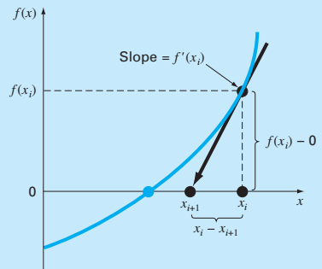
Newton Raphson Method
A faster alternative is to use a numerical rootfinder.
Only one Guess point is needed.
Initial guess at the root is x_{i}, a tangent can be extended from the point [x_{i}, f(x_{i})].
The point where this tangent crosses the x axis usually represents an improved estimate of the root.

Slide 9

Newton Raphson Method
Step 1: Evaluate f’(x) symbolically and guess initial root x_{i} .
Step 2: Calculate new value of the root,
Step 3: Find the absolute relative approximate error as :
Step 4: Compare the absolute relative approximate error with the pre-specified tolerance |ε_{s}|
(a) If |ε_{a}| > |ε_{s}|, return to step 2 and calculate new value of root.
(b) If |ε_{a}| < |ε_{s}|, Terminate the computation.
$$\left|∈_{a}\right| = \left|\frac{x_{i+1}− x_{i}}{x_{i+1}}\right| × 100$$

Slide 10
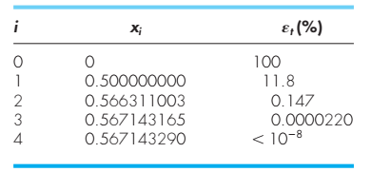
Newton Raphson Method
Example 1: find the root of f(x) = e^{-x} − x
Initial Guess x₀ = 0; f(x₀) = 1,
f’(x) = - e^{-x} − 1 , f’(x₀) = -2
Iterations:
x₁ = x₀ – (f(x₀) /(f’(x₀₎) = 0-(-1/2) =0.5
x₂ = x₁ – (f(x₁) /(f’(x₁₎) = 0.5-(-0.1/1.6) =0.566

Slide 11
MATLAB© Script
MATLAB Program for Newton Raphson Method
clear all
clc
tol = 1e-5;
x0 = 0 ; % Guess
i =1;
maxitr =1000;
xold = x0;
syms z
fun=exp(z) +15*z -10;
fx_diff=diff(fun,z);
while i < maxitr
fx = subs(fun,z,xold);
Fx = vpa(fx);
fx1 = subs(fx_diff, z, xold);
Fx1 =vpa(fx1);
x = xold - Fx/Fx1;
if abs(x-xold) > tol
xold = x;
i = i +1;
else
disp('Root calculated')
x
return
end
end

Slide 12
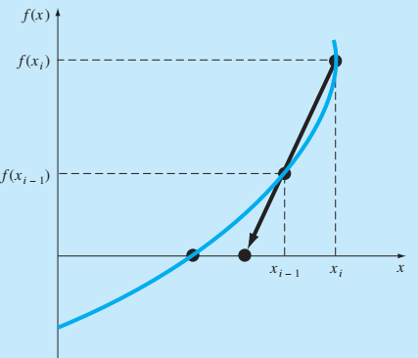
Secant Method
A faster alternative is to use a numerical rootfinder.
Two initial point is needed.
No need of function derivative calculation.
Root is predicted by extrapolating tangent of
function to x-axis.
Modified form of Newton-Raphson to avoid function derivative calculation.
Function derivative approximated by backward
finite divided difference.
Newton-Raphson
Secant

Slide 13
Secant Method
Step 1: Guess initial root x_{i-1} and x_{i} .
Step 2: Calculate new value of the root,
Step 3: Find the absolute relative approximate error as :
Step 4: Compare the absolute relative approximate error with the pre-specified tolerance |ε_{s}|
(a) If |ε_{a}| > |ε_{s}|, return to step 2 and calculate new value of root.
(b) If |ε_{a}| < |ε_{s}|, Terminate the computation.
$$\left|∈_{a}\right| = \left|\frac{x_{i+1}− x_{i}}{x_{i+1}}\right| × 100$$

Slide 14
MATLAB© Script
MATLAB Program for Secant Method
if abs(x(i)-x(i-1)) < tol
disp('Root calculated')
x(i)
i
return
else
i = i +1;
end
end
%Define function file
function y =secfun(x)
y = exp(x) -15*x -10;
clear all
clc
tol = 1e-5;
x = [1 5]; % Guess
i =3;
maxitr =1000;
while i < maxitr
f1 = secfun(x(i-2));
f2 = secfun(x(i-1));
fact = (f2*(x(i-2)-x(i-1)))/(f1-f2);
x(i) = x(i-1) - fact;

Slide 15
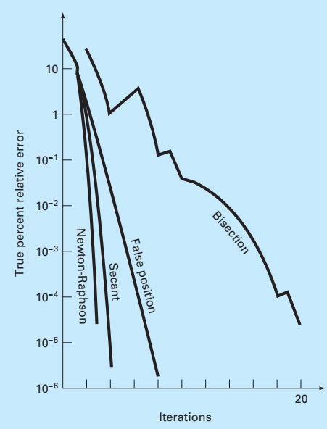
Convergence

Slide 16


THANK YOU
Questions??

